Slide 1


SVN Repository Comparison tool
Jayganesh Sambath
Thomson Elite
September 2013

Slide 2
Agenda
What is EasySVNdiff?
General Background
Benefits of EasySVNdiff
Using EasySVNdiff
Questions

Slide 3
What is EasySVNdiff?
EasySVNdiff is a tool to compare two given SVN Server Repository URLs.
It is a stand-alone application that runs on Windows environment.
Specifically developed for comparing Backed up SVN repository.
It was developed using Microsoft .NET Framework 4.0 and C# with Visual Studio 2010.
Notes:
3

Slide 4
General Background
Problem description
Some Projects are using SVN as their Source Control. Repositories of those projects are backed up by IT team on a regular basis.
To ensure that back up data are intact, there is a quality process in place called Backup Restoration Verification.
CLs of Projects have to get the restored data and compare with live data and have to document the activity.
CLs find it difficult in verifying the backup data and ensuring the correctness.
Time taken to do the process is two or more hours.
Notes:
4

Slide 5
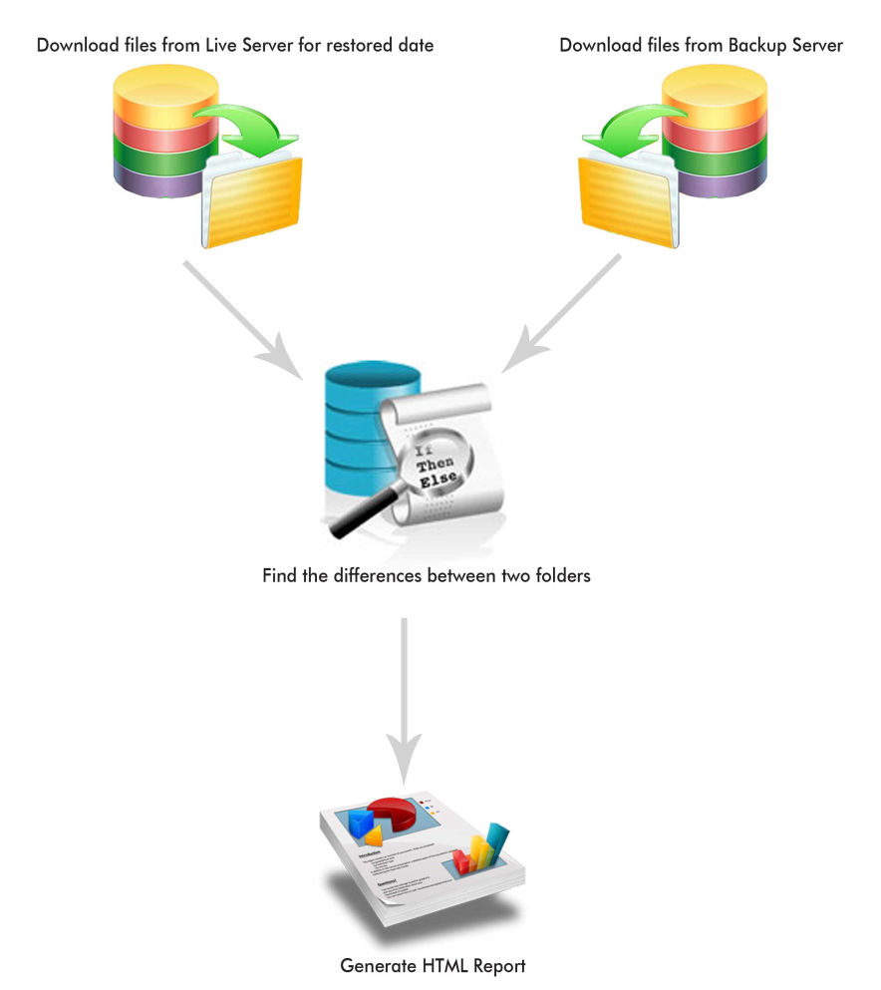
General Background
Requirements
Compare both repositories thoroughly
Make the task easier
Notes:
5

Slide 6
Benefits
EasySVNdiff automates the whole processes
Easy to use
5 to 10 minutes of efforts required
100% guarantee on the comparision
Intuitive GUI
Option to have detailed process log
Easy to know the differences
Option to generate the report in HTML format
Notes:
6

Slide 7
Using EasySVNdiff
VBScript is a general-purpose scripting language.
Widely used among system administrators in the Microsoft environment.
Preferred scripting language in Test Automation tools e.g. QuickTest Pro
VBScript is simple but powerful; easy to learn and use.
Hosts of VBScript
Internet Explorer
Internet Information Server
Windows Scripting Host
Web development:
Similar to JavaScript
Form validation
Access DOM/ XML
Targeted for Internet Explorer
Active Server Pages (ASP) fully supports VBScript for server side scripting
HTML Applications (HTA)
Notes:
7

Slide 8
Capabilities of VBScript
System Administrator’s Favorite Language
Access IIS Metabase
File System operations- Create/ Copy/ Move/ Delete
Work with Binary data using ADODB.Stream
Active Directory Maintenance
WMI (Windows Management Instrumentation) Scripting
Access/ Create MS office documents
Automation:
Automating software applications for repeated activities (e.g. Server Uptime check)
Can create stand-alone applications that run directly in Windows under WSH.
Software Build automation
Testing Automation- QTP and other tools adopted VBScript
Access Database using ADO
Notes:
8

Slide 9
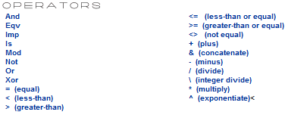
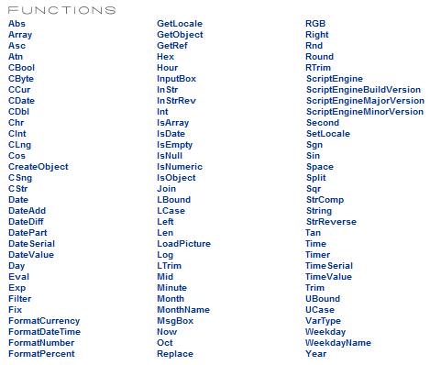
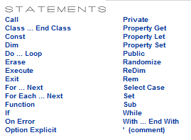
A Quick VBScript Language Reference
VBScript is modelled on Visual Basic language
Like VB, it’s case-insensitive
A VBScript program has ‘.vbs’ file extension
Notes:
9

Slide 10
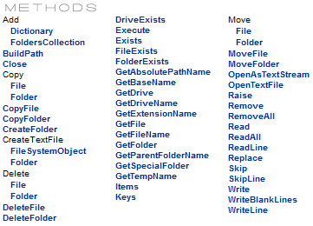
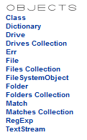
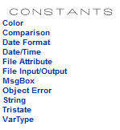
A Quick VBScript Language Reference
Continued..
Variables by default have “Variant” type, but it is possible to force a particular type (integer, date, etc.) using conversion functions (Cint, CDate, etc.)
Comments- Single quote or ‘REM’ keyword
User interaction is provided through the functions MsgBox and InputBox
Debugging is done using ‘STOP’ keyword
Notes:
10

Slide 11
A Quick VBScript Language Reference
Executing a VBScript program
Stand-alone program
Two ways:
Using “cscript.exe” in Console/ Command line
Using “Wscript.exe”
Using “cscript.exe”: Microsoft’s Console based Script Host ( part of WSH)
Using “wscript”: Microsoft Windows Scripting Host (WSH)
Executing a program using command line
C:\> cscript hello.vbs
Executing via wscript
Double clicking the file in Windows Explorer or Desktop, it will be executed.
Notes:
11

Slide 12

VBScript Demo
The Greatness of VBScript
Executing a VbScript program
Example: Using SendKeys
Opening Notepad using VBScript
Set shl = createobject("wscript.shell") shl.Run "Notepad.exe" wscript.sleep 1000 shl.sendkeys "{ENTER}" shl.sendkeys "Welcome" wscript.sleep 500 shl.sendkeys " To" wscript.sleep 500 shl.sendkeys " 'Train the Trainers' program!" wscript.sleep 500 shl.sendkeys "{ENTER}{ENTER}" wscript.sleep 500 shl.sendkeys "Thank you!" wscript.sleep 500 shl.sendkeys "^{s}" wscript.sleep 500 shl.sendkeys "VBSdemo.txt" wscript.sleep 500 shl.sendkeys "{ENTER}" wscript.sleep 500 shl.sendkeys "%{F4}" Shl.popup "Demo is done!",1,"Thank you!" set shl= Nothing
Notes:
12

Slide 13
Thank You!
© CSS Corp – Copyright Notice:
This presentation contains proprietary information of CSS Corp. No part of this presentation may be reproduced, stored, copied, or transmitted in any form or by means of electronic, mechanical, photocopying or otherwise, without the express consent of CSS Corp. This presentation is for a specific intended audience circulation only and not meant for external distribution. Information is classified into 4 levels:
Confidential: This is specifically restricted to the Senior Management and specific professional advisers.
Restricted: This is restricted to Senior Management (PA’s and assistants can also access subject to respective reporting head’s approval).
Private: This covers all information assets that have value but which do not need to fall within either of the other categories.
Public: This is information which can be released outside the Organization.

